Slide 1
RETAIL SALES FORECASTING
CKME136: CAPSTONE PROJECT
John-Paul Otieno

Slide 2
Retail Store: Walmart
Founded in July 2, 1962
Revenue – $485.86 billion for the 2016 fiscal year
11,695 stores world wide
Number of employees 2.3 million world wide and 1.4 million in the U.S as of 2016
260 million customers each week

Slide 3
About the data
Kaggle Competition
www.kaggle.com/c/walmart-recruiting-store-sales-forecasting
Goal: Forecast sales for each department of each store
Use multiple points if necessary.

Slide 4
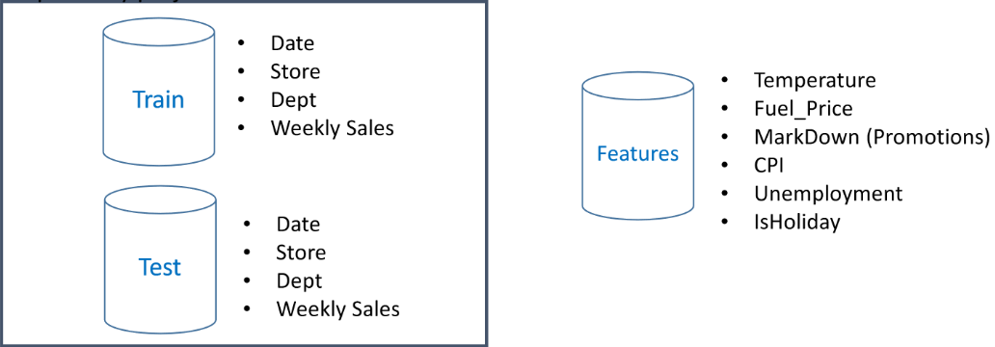
Data Description

Slide 5
Data Preparation
I begin with 3 data sets:
train.csv: Historical training data from 5/2/2010 to 26/10/2011, containing columns for Store, Dept, Date, Weekly_Sales and IsHoliday - 421570 records
test.csv: Test data for 2/11/2012 to 26/7/2013, containing columns for Store, Department, Date and IsHoliday – 115064 records
Features.csv: Contains additional data related to the store, department and regional activity within the given dates. It contains Store, Date, Temperature, Fuel_Price, Markdown 1-5, CPI, Unemployment, IsHoliday – 8190 records

Slide 6
About The Data
<Features>
·Store - the store number
·Date - the week
·Temperature - average temperature in the region
·Fuel Price - cost of fuel in the region
·MarkDown1-5 - data is only available after Nov 2011,
·CPI - the consumer price index
·Unemployment - the unemployment rate
·IsHoliday - whether the week is a special holiday week
<Feature> provided parameters may affect weekly sales, but did not provide weekly sales.
<Train>
Store - the store number
·Dept - the departmet number
·Date - the week
·Weekly Sales - sales for the given department in the given store
·IsHoliday - whether the week is a special holiday week
<Train> provided sales data of 45 stores with up to 99 departments in more than 421,000 records, and didn’t sum each store’s weekly sales up.

Slide 7
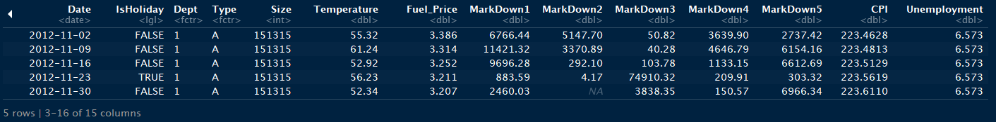
Load And Explore The Data
train.csv
2-5-2010 to 10-26-2012
143 weeks
test.csv
11-2-2012 to 7-26-2013
39 weeks
features.csv
2-5-2010 to 7-26-2013
77 weeks
Merged 3 data sets for convenience of analysis

Slide 8
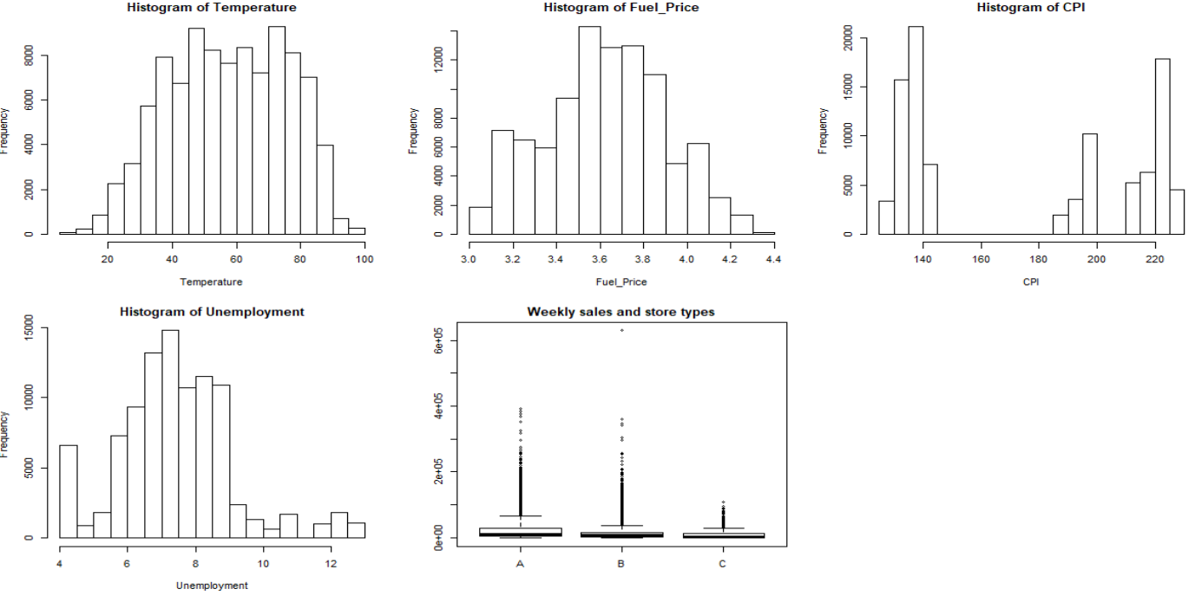
Explore The Data

Slide 9
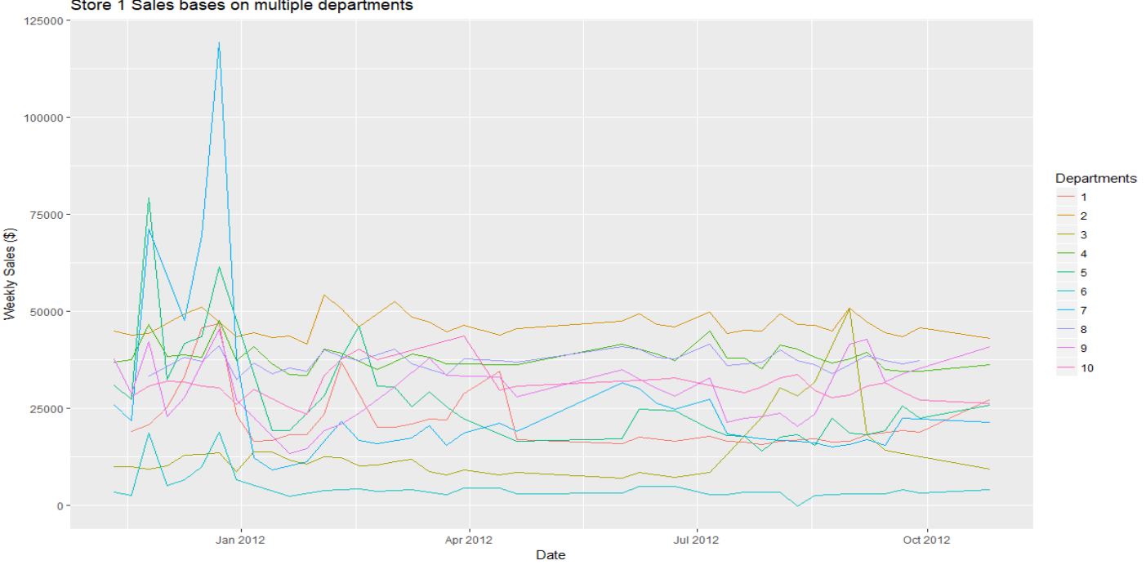
Exploring the data
Weekly store sales by departments

Slide 10
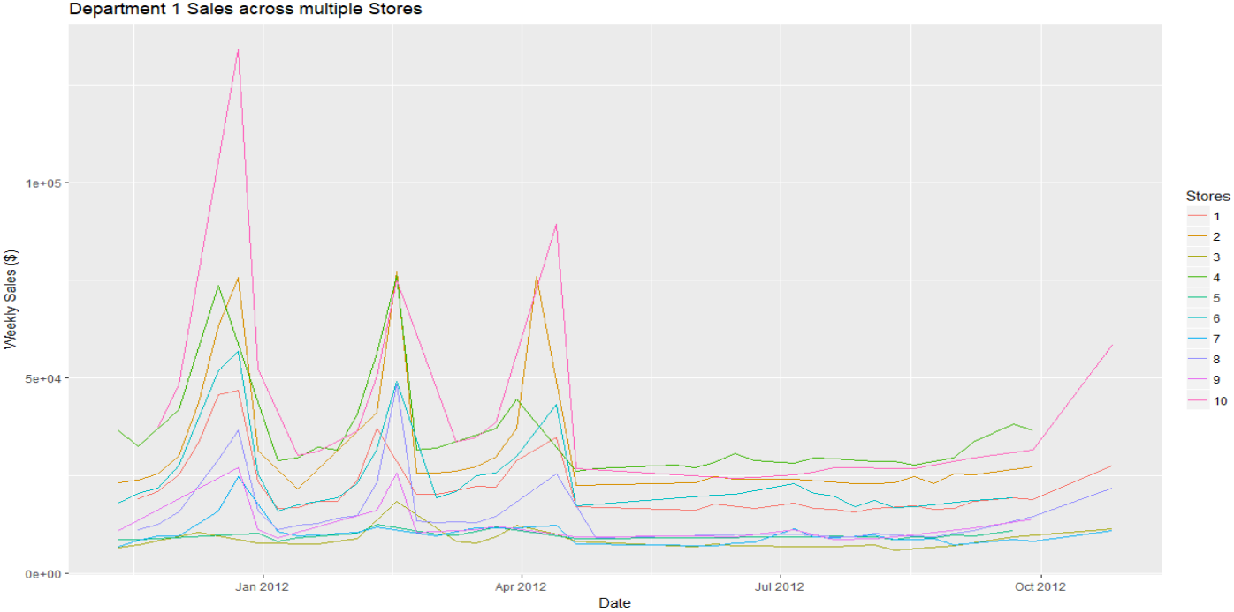
Explore Data
Departments are performing the same across Stores

Slide 11
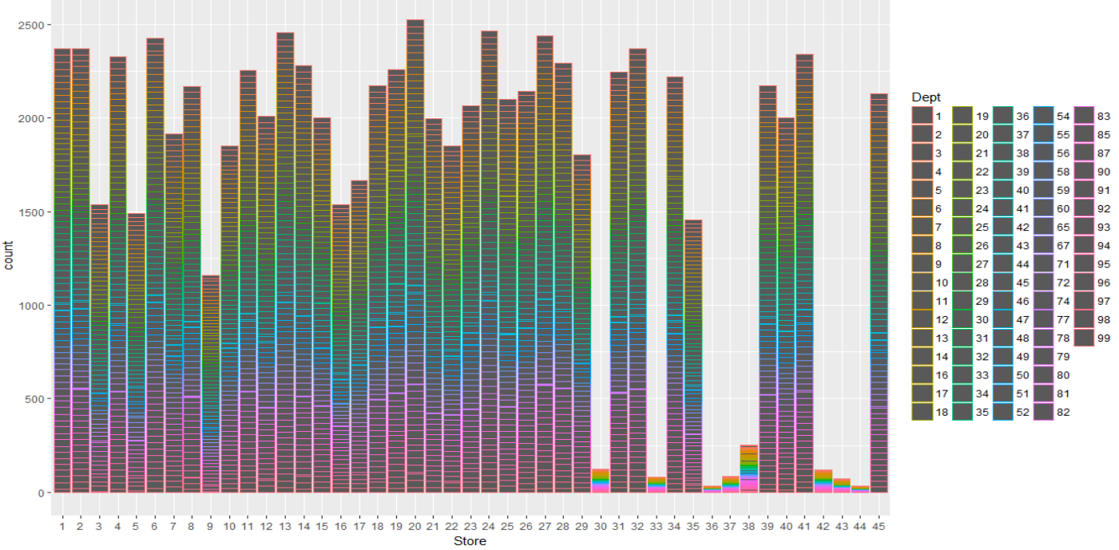
Exploratory Data Analysis
Comparing the features with the Weekly Sales

Slide 12
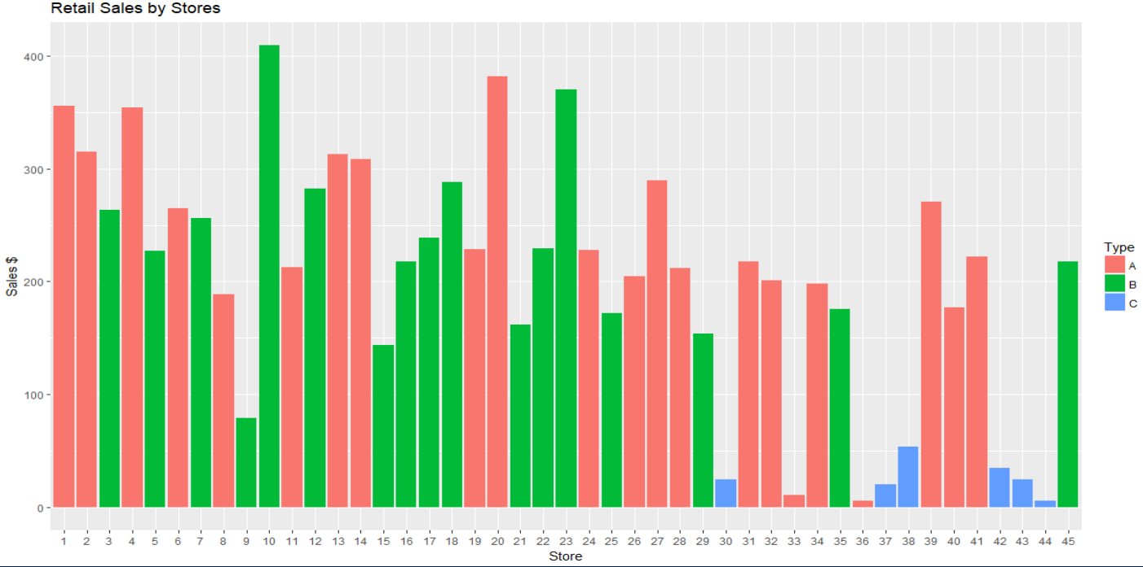
Explore data
Sales by store type

Slide 13
Time Series Analysis
Define an ARIMA function that fits model
Train the model
The results indicate that the most appropriate model for our Weekly sales
time series is the ARIMA(2, 2, 2) model. We can train this model again with these parameters:

Slide 14
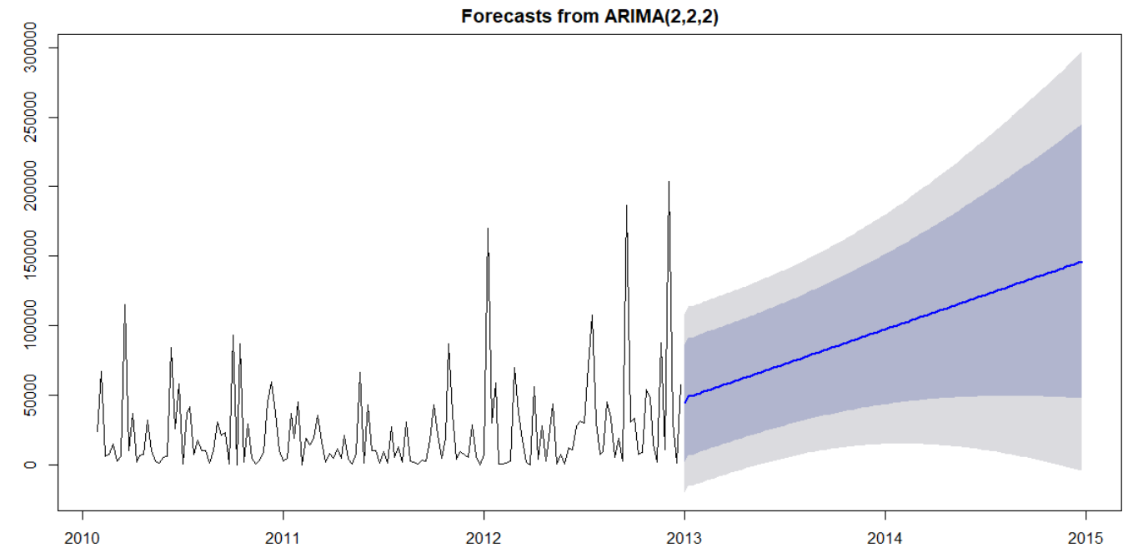
Model

Slide 15
Recommendation
Further investigate other external features
What to do next.
Identify other algorthimns that would work with this model

Slide 16
Questions?

